Slide 1
Exploring SG’s
Public Bus
Transport System
By Ashley Bai (P2237871)

Slide 2
Objectives
1. How has Singapore’s bus system changed from the past and its impact on commuters?
What is the effect of distance travelled by buses over time on commuters?
What is the effect of accessibility of buses on commuters?
Number of bus facilities over time
Number of buses by passenger capacity over time
2. Has buses in Singapore bring convenience to our lives?
What is the distribution of bus stops in Singapore?
What is the Bus Frequency like in the morning peak hour by bus operator?
What is the Bus Frequency like in the evening peak hour by bus type?

Slide 3
URL OF DATASETS
01
02
03
04
05
06
RIDERSHIP
BUS DISTANCE
https://data.gov.sg/dataset/public-transport-utilisation-average-public-transport-ridership
Average daily number of trips made islandwide on MRT, LRT, bus & taxi. (1995-2016)
https://data.gov.sg/dataset/public-transport-capacity-average-daily-km-travelled-and-bus-routes-in-operation
Distance travelled by rail and bus. (2004-2013)
BUS POPULATION
BUS FACILITIES
https://data.gov.sg/dataset/annual-age-bus-population-by-passenger-capacity
All buses registered in Singapore, based on its passenger capacity. (2005-2017)
https://data.gov.sg/dataset/commuter-facilities
All bus stops, bus interchanges, bus terminals, taxi stands in Singapore. (2002-2013)
BUS STOPS
BUS SERVICES
Given dataset from kaggle
Given dataset from kaggle

Slide 4
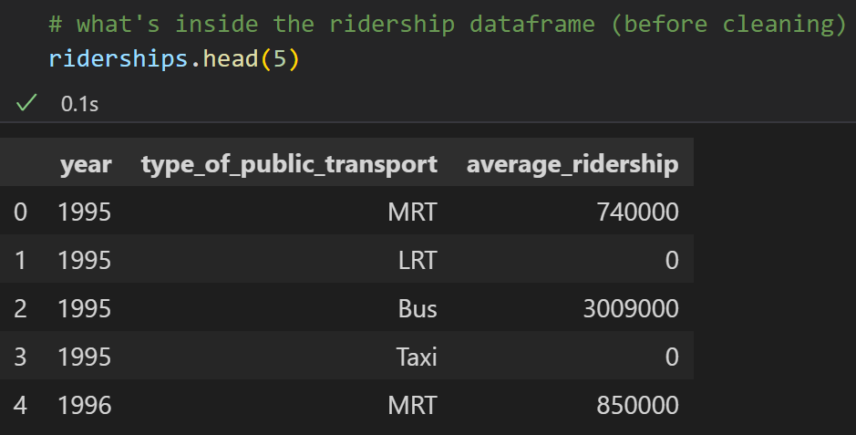
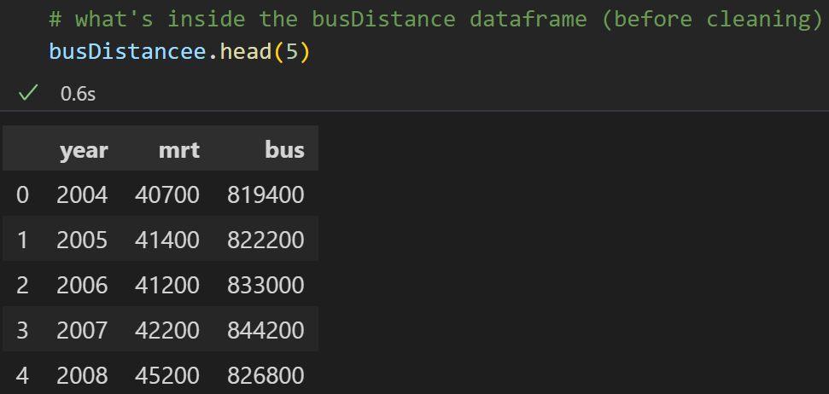
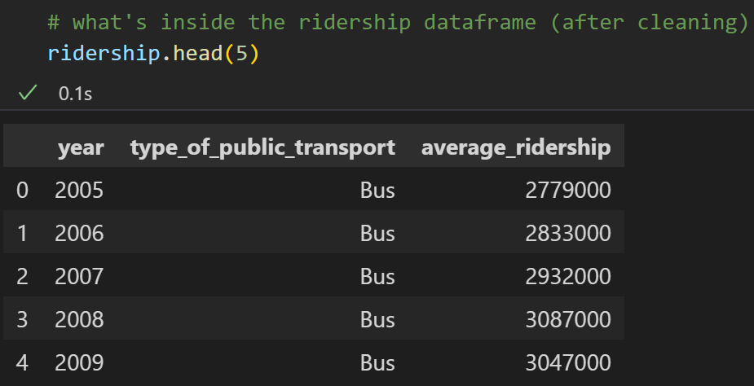
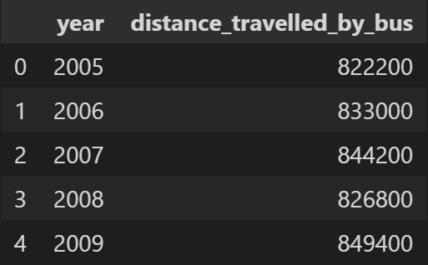
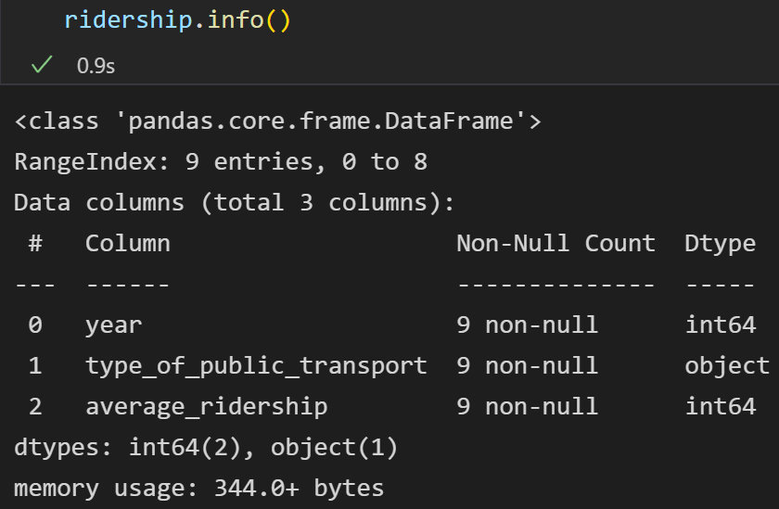
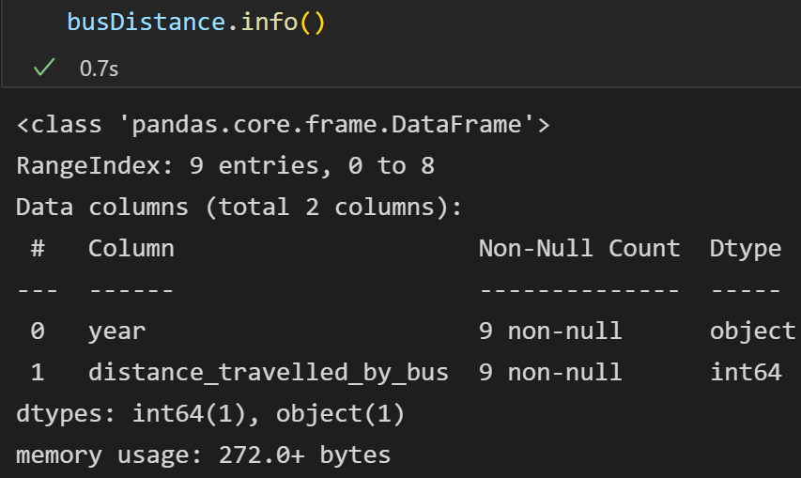
01 - RIDERSHIP
02 - BUS DISTANCE
NATURE OF DATASETS AFTER CLEANING
BEFORE:
BEFORE:
AFTER:
Contains qualitative and quantitative data.
Dropped NA, MRT, LRT, Taxi data, and years not between 2005-2013.
No missing/null values.
No outliers.
Integer/string dtypes.
AFTER:
Contains quantitative data.
Dropped NA, mrt data, and years not between 2005-2013.
Renamed column.
Changed dtype of year.
No missing/null values.
No outliers.
Integer/string dtypes.

Slide 5
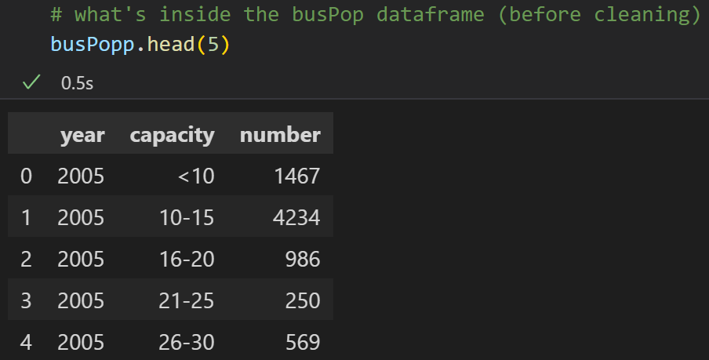
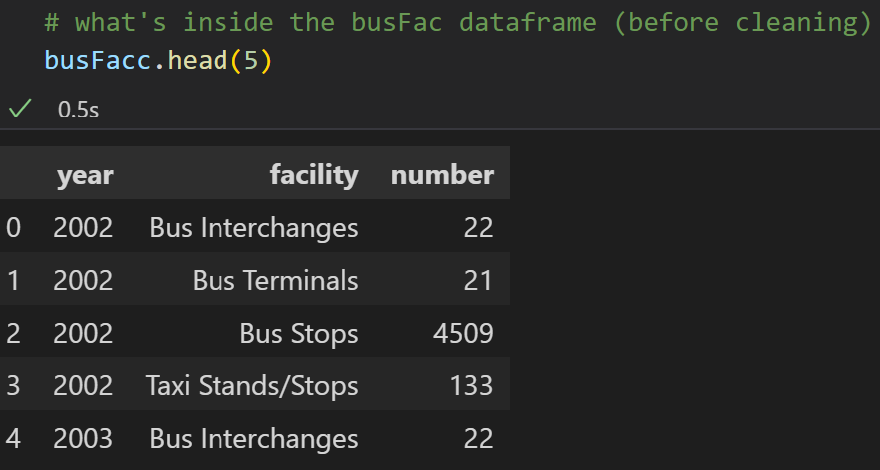
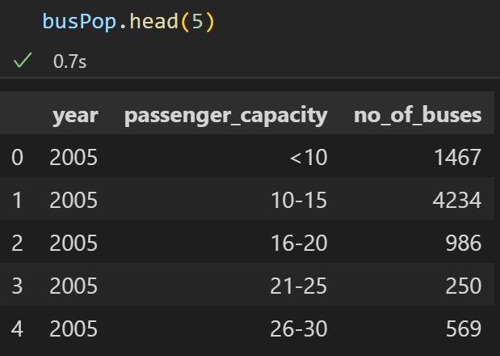
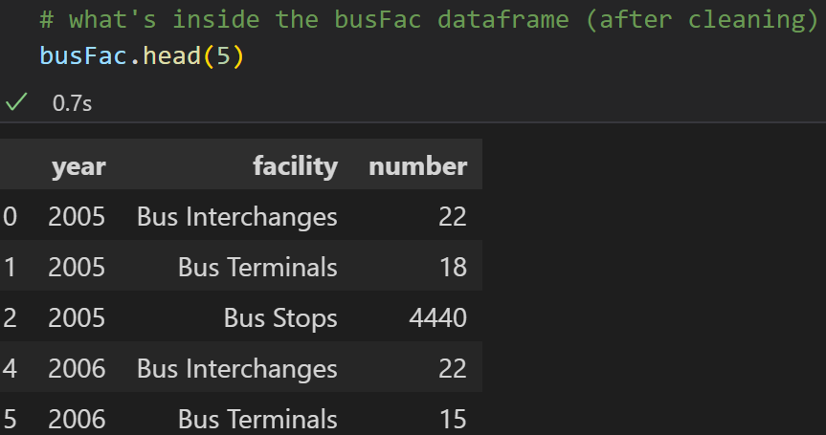
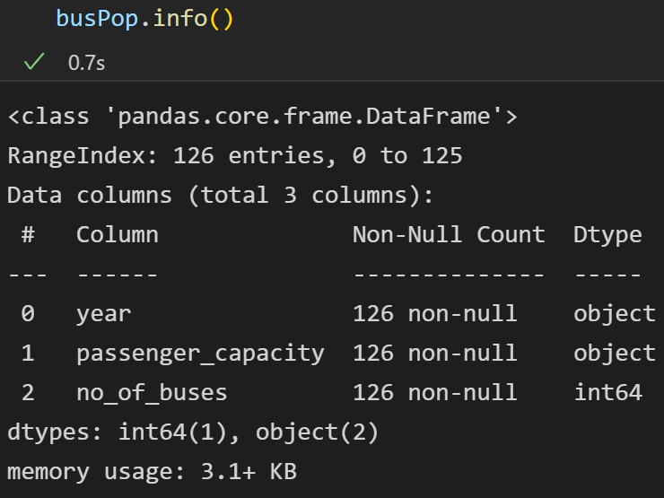
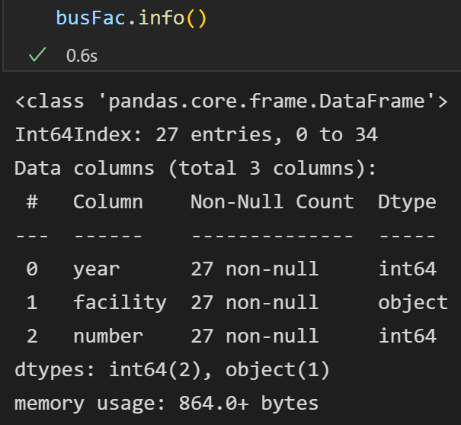
03 - BUS POPULATION
04 - BUS FACILITIES
NATURE OF DATASETS AFTER CLEANING
BEFORE:
BEFORE:
Contains qualitative and quantitative data.
Dropped NA, and years not between 2005-2013.
Renamed columns.
Changed dtype of year.
No missing/null values.
Outliers were not removed as they are relevant to my analysis.
Integer/string dtypes.
Contains quantitative and qualitative data.
Dropped NA, Taxi data, and years not between 2005-2013.
No missing/null values.
No outliers.
Integer/string dtypes.
AFTER:
AFTER:

Slide 6
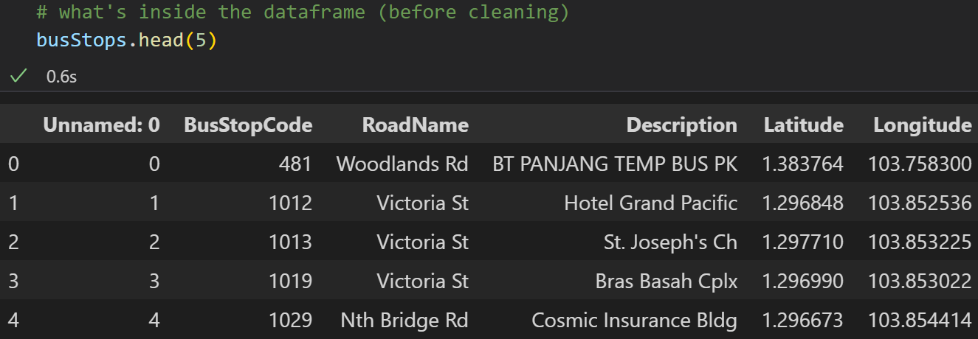
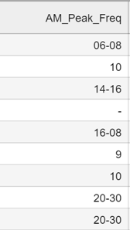
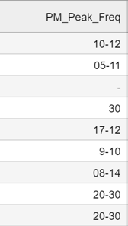
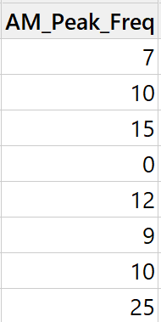
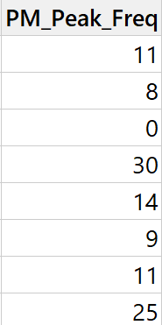
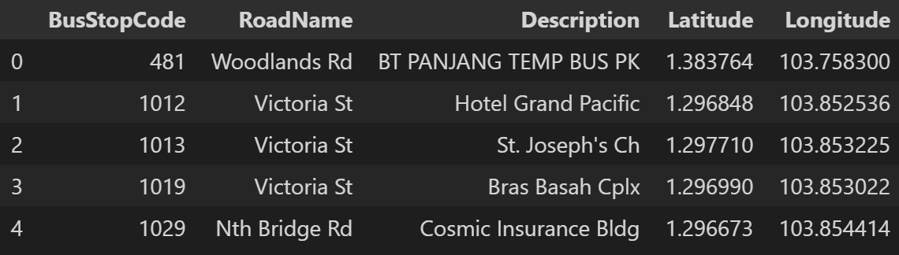
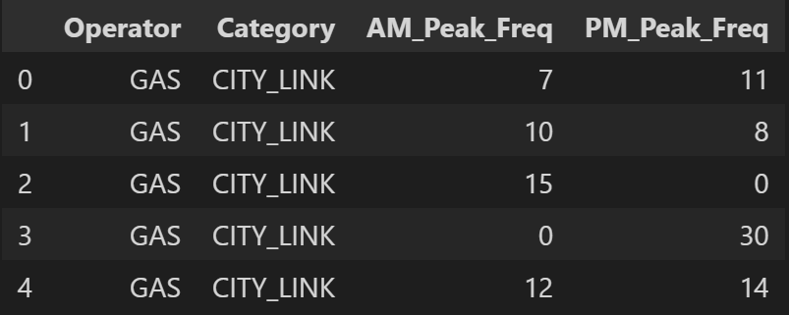
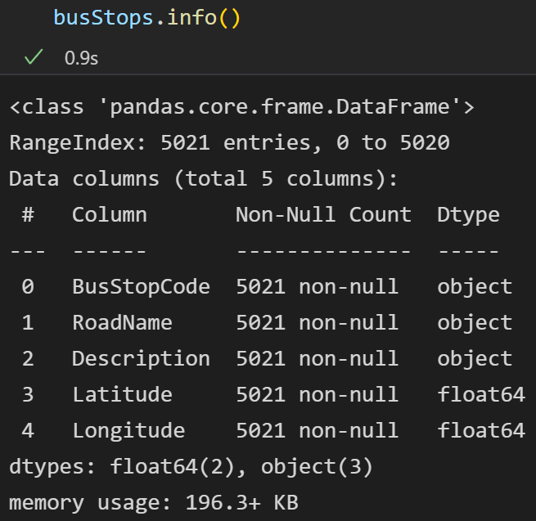
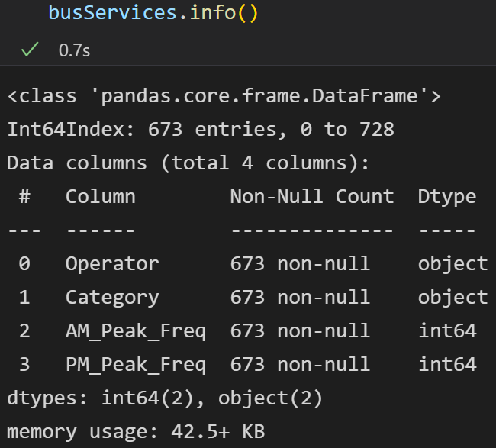
05 - BUS STOPS
06 - BUS SERVICES
BEFORE:
BEFORE:
AFTER:
Contains qualitative and quantitative data.
Dropped NA, and columns.
Renamed columns.
Changed dtype of BusStopCode.
No missing/null values.
Float/string dtypes.
AFTER:
‘AM_Peak_Freq’ & ‘PM_Peak_Freq’ wrangled via excel.
Contains quantitative and qualitative data.
Dropped NA, certain columns, rows of ‘Category’ that contain “FLAT FARE”, and certain operators.
No missing/null values.
Outliers need not be removed.
Integer/string dtypes.

Slide 7
Objective 1
How has Singapore’s bus system changed from the past and its impact on commuters?

Slide 8
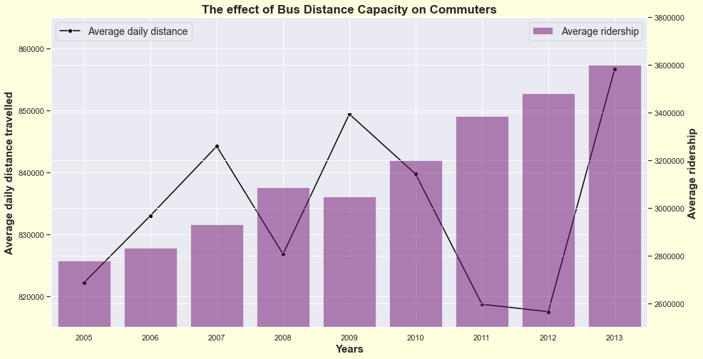
OBJ 1: INSIGHTS 1
What is the effect of distance travelled by buses over time on commuters?
SEABORN GRAPHS
Used sns.lineplot and sns.barplot to plot this graph on a twin axis, to show the relationship.
INSIGHTS GAINED
Over the years, average ridership is not affected by the average daily distance travelled by buses.
As average ridership generally increases from 2005 to 2013, the average daily distance shows a trend of fluctuation, which could be due to the fact that commuters opted MRT, LRT, Taxi/Grab instead or they only travelled short distances.
Overall, average ridership is the highest in 2013 when average daily distance is also the highest.

Slide 9
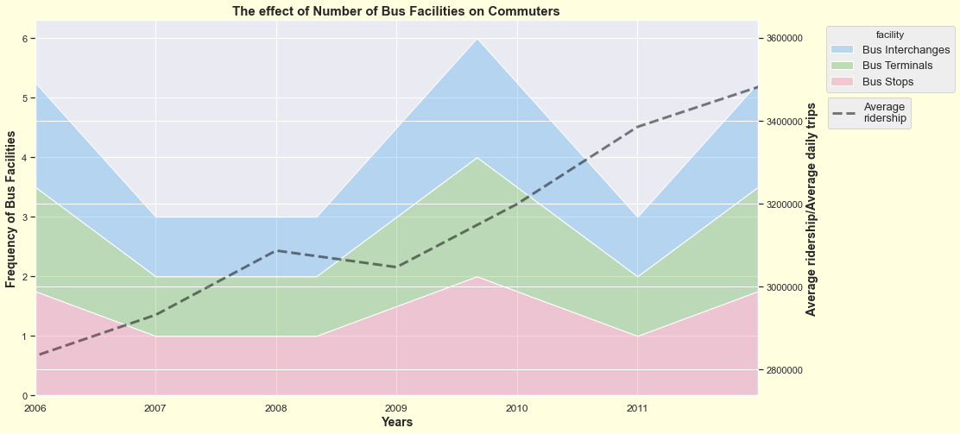
OBJ 1: INSIGHTS 2
What is the effect of accessibility to
more bus facilities over time on commuters?
SEABORN GRAPHS
Used sns.lineplot and sns.histplot to plot this graph on a twin axis, to show the relationship.
INSIGHTS GAINED
The number of bus facilities and average ridership increased from 2006 to 2012.
The frequency of bus stops is the greatest, while that of bus interchanges is the lowest.
The frequency of bus facilities were highest in around 2010 where average ridership continuously increased steeply.
There is a positive correlation between the number of bus facilities and the average ridership, implying that more bus facilities makes buses more accessible to commuters, hence increasing bus ridership.

Slide 10
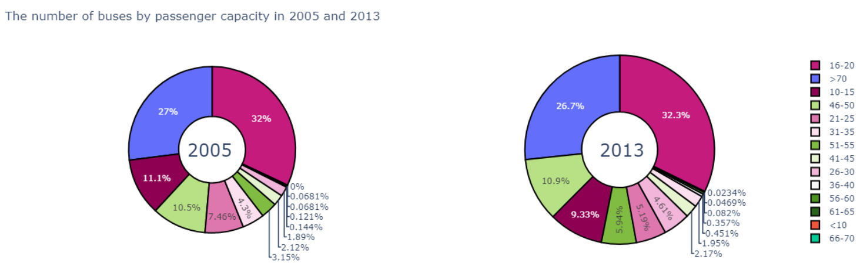
OBJ 1: INSIGHTS 3
What is the effect of accessibility to buses with higher passenger capacity on commuters?
PLOTLY PIE CHARTS
Using plotly.graph_objects, i created 2 interactive pie charts which can be hovered over, to compare the number of buses by passenger capacity of past and present.
INSIGHTS GAINED
FURTHER INSIGHTS GAINED
Largest number of buses with a passenger capacity (16-20), continues to increase from 32% in 2005 to 32.3% in 2013.
The second largest number of buses are those with a capacity of more than 70 passengers, of more than 26% in both past and present.
Largest bus capacity (>70) , decreased from 27% in 2005 to 26.7% in 2013.
The decrease in number of (>70) buses could be due to using resources to make more smaller capacity buses.
This suggests that Singapore’s bus transport system has provided people with accessibility to more buses that can carry more passengers, benefitting both the environment and people as travelling time can be saved.

Slide 11
Objective 2
Has buses in Singapore bring convenience to our daily lives?

Slide 12
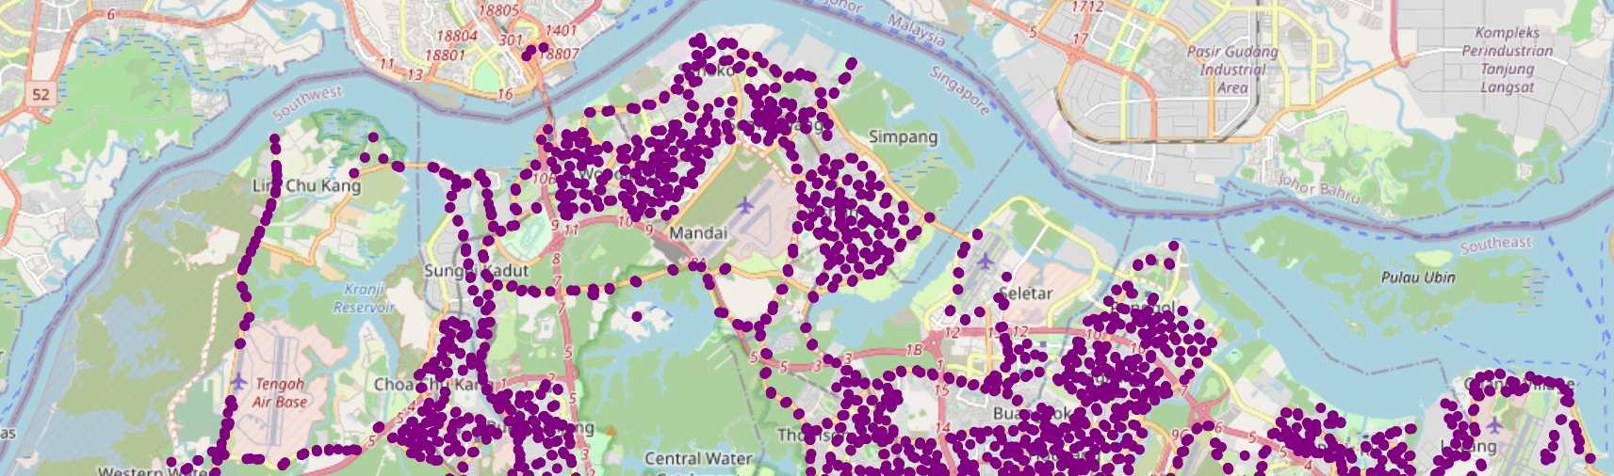
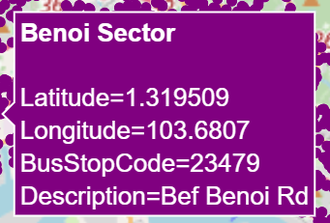
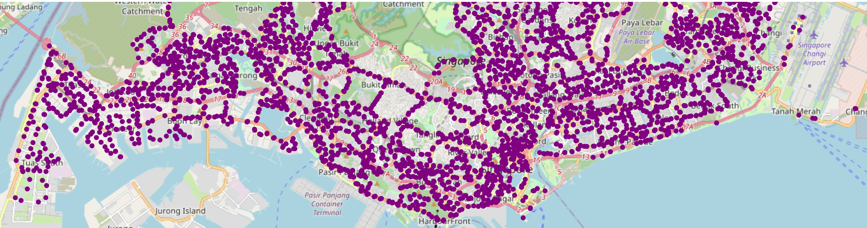
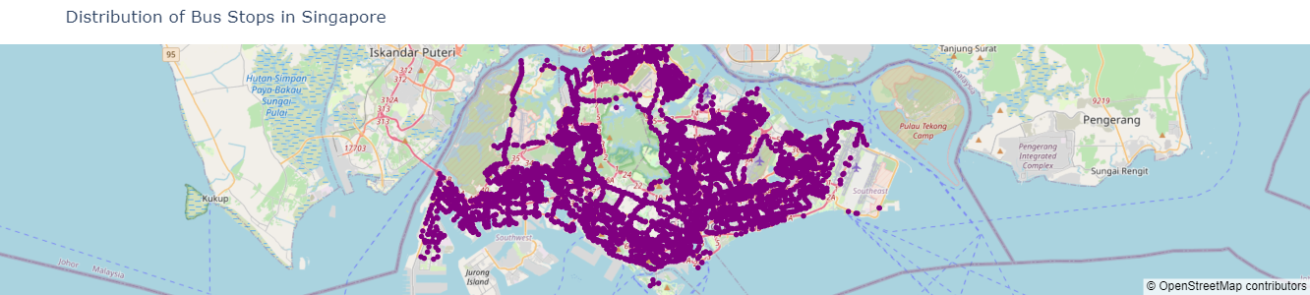
OBJ 2: INSIGHTS 1
What is the distribution of bus stops in Singapore?
PLOTLY SCATTER MAPBOX
Used plotly to plot an interactive scatter mapbox, that can be hovered over showing bus stop code and location.
INSIGHTS GAINED
Bus stops are concentrated and distributed all around Singapore, except in air bases, reservoirs, water catchment areas.
There are many bus stops near residential areas.
As such, the bus system in Singapore allows people to conveniently find bus stops easily and get to their destinations faster.

Slide 13
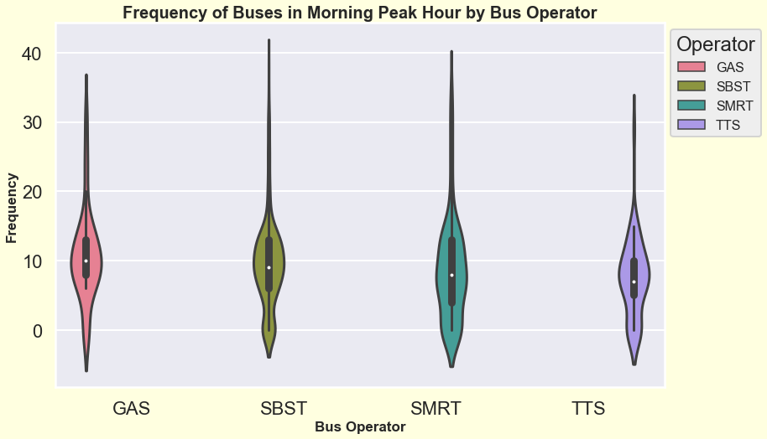
OBJ 2: INSIGHTS 2
What is the bus frequency like in the
morning peak hour by bus operator?
SEABORN VIOLIN PLOT
Used sns.violinplot to show the relationship of bus operator to bus frequencies.
INSIGHTS GAINED
The box plot elements suggests that the median frequency of the different bus operators are similar (7-10 min).
Gas bus operators has the highest median frequency while TTS has lowest.
The shape of the distribution is extremely skinny on each end and wide in the middle, indicating the frequencies of the buses are highly concentrated around the median.

Slide 14
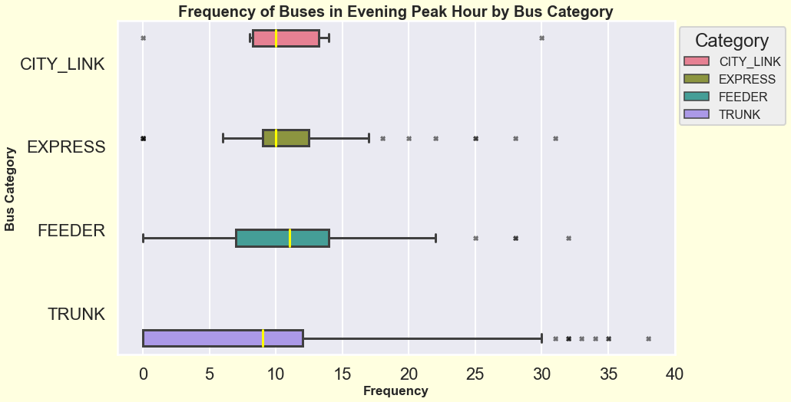
OBJ 2: INSIGHTS 3
SEABORN BOX PLOT
What is the bus frequency like in the
evening peak hour by bus type?
Used sns.boxplot to show the distribution of frequencies for each bus category.
INSIGHTS GAINED
Feeder buses has the highest median frequency, Trunk buses has the lowest.
Data is not normally distributed.
City link, Express and Trunk buses are positively skewed (the data constitutes of higher frequency of bus timings), as compared to Feeder buses which is negatively skewed.
Trunk buses seem to have the largest IQR (more dispersed) while Express buses have the smallest (less dispersed).

Slide 15
FURTHER INSIGHTS GAINED
Therefore, the violin plot suggests that the probability of bus frequency being accurate and consistent during morning peak hour is high.
This suggests that Singapore’s Bus System is reliable as people will have the confidence that buses will most likely frequently between 7 to 10 mins on average, allowing them to manage their time before going to work/school, bringing convenience to their daily lives.
Trunk services are long bus routes that connect different neighbourhoods across the island, or into the City area, and are most frequently used in Singapore.
From the boxplot, Trunk buses have the lowest median frequency of bus timing (8 minutes), allowing more people to get to their destinations in a shorter amount of time.
In conclusion, Singapore’s public bus transport system has improved from the past, catering to the needs of the people, as well as improving their standard of living by providing effiency and accessibility. From the data analysis, it can be predicted that the system will continue to improve! Thank you!

